Slide 1

Software Architect
System Design Problem

Slide 2

Marc J. Greenberg http://codemarc.net
Who is codemarc?
1980’s syr.edu IBM Bing, Boca, Rochacha OS/2, AS400 RexxSaa
1990’s NYC FOCUS
Information Builders Communications Dev / Architect Client/Server, Api’s, Sdk's
2000’s iWay Spinoff iWay Software Service Manager ESB, Adapter Framework, Eclipse Messaging Strategy, Channel Selling
2010’s Cloud Focused Containers, IPaaS, Cep, Big Data, MDM, Data Quality - Cleansing - Insights
2016’s - Present Startups Smash Data, Building and Linking, Voice + Data, MC, Embedded, f5, EaaS Cloud Native
Intro

Slide 3
Requirements expressed as MECE (mutually exclusive, collectedly exhausted)
Member
Book
System
update documents (all office doctypes + image, sound and movie)
event triggered - transpile/compile resilient, fault tolerant, scalable (to 100K/cpd)
portfolio pdf’s, searchable, annotatable
role based permissions (redact or remove)
all artifacts geographically distributed, secure at rest and in flight (downloadable)
distributed log, observable, monitorable, instrumented
notification on update (by text, email, tweet, preference based)
scalable (to 100s of docs, 1000s of pages)
customizable (cover page, table of contents)
NFR
Composability
Useability
Securability
Scalability
Reliability
Durability
2
approach
Notes:
Rule of 3’s or 5’s
(3) The Good, The Bad, The Ugly
(4) The Cook, The Thief, His Wife and Her Lover.

Slide 4
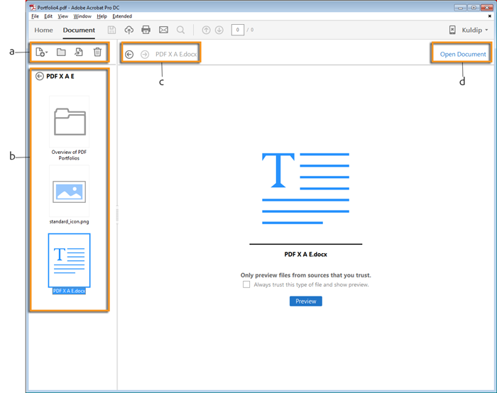
Discovery – What is a Book?
PDF Portfolio is a collection of files that are gathered and saved into a PDF container.
Like a zip archive or an office doc (structured storage, embedded spreadsheets, images, inception)
Api’s/Sdk’s to create /secure / manipulate
Adobe PDF Tools
jPDFProcess
Aspose.PDF
PDFTron
ITEXT
3
methods
Notes:
since 1993

Slide 5
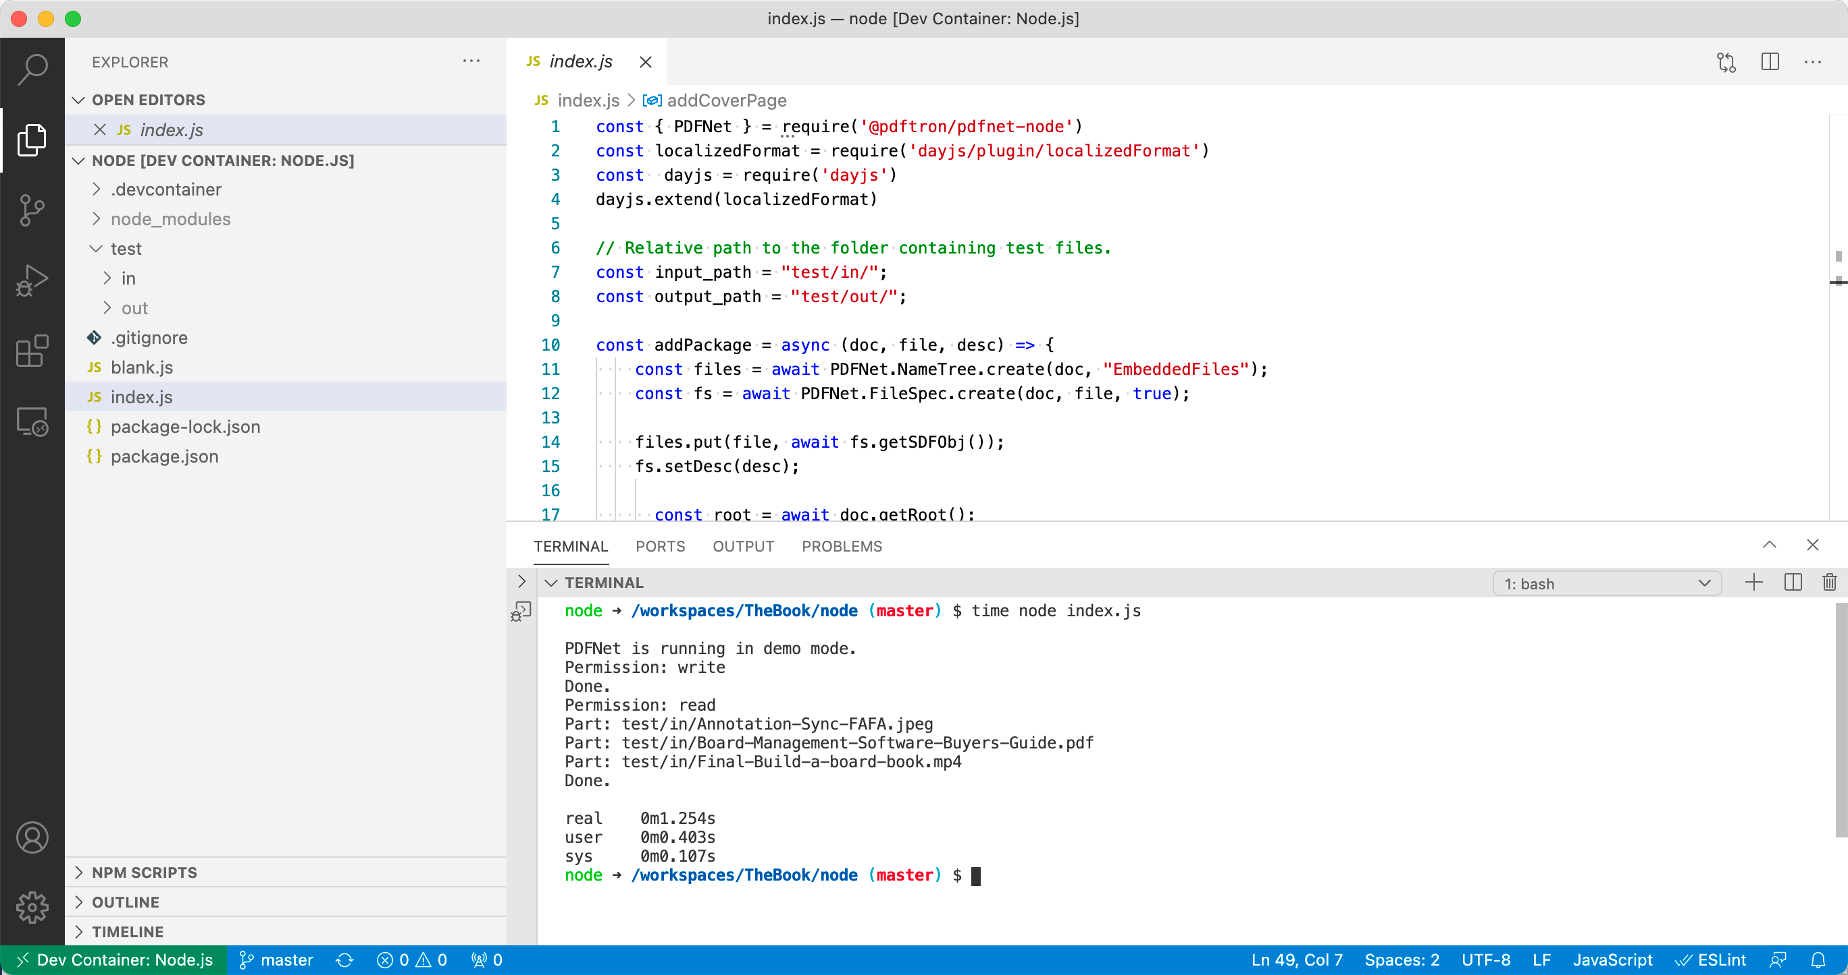
4
methods
Notes:
since 1993

Slide 6
Discovery – What is a Member?
A member of a collaboration team
Identity
Authentication / Authorization
Privileges (granularity)
Role Basis
Content Based Roles
Author
Editor
Reviewer
Calculated
Path based
Bitmapped (level1, leve2, level3)
Data Policies
at Rest vs Inflight
Retention
Redact vs Remove
By page?
By item?
5
methods

Slide 7
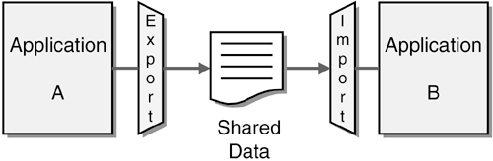
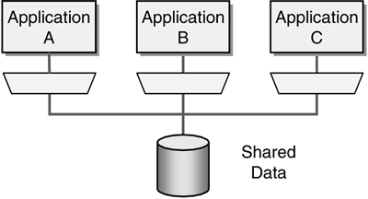
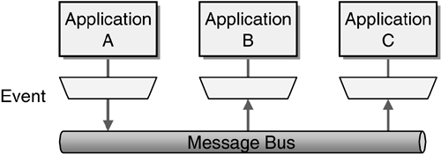
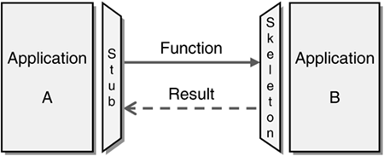
System - Integration Architectures
File Transfer Applications share data by exchanging files. They use the export (producer) or import (consumer) patterns
Shared Database Applications store the data they wish to share in a common database
Remote Procedure Applications share data by expose functionality that can be invoked remotely
Message Passing Applications share data by exchanging messages thru a common messaging system
6
methods

Slide 8


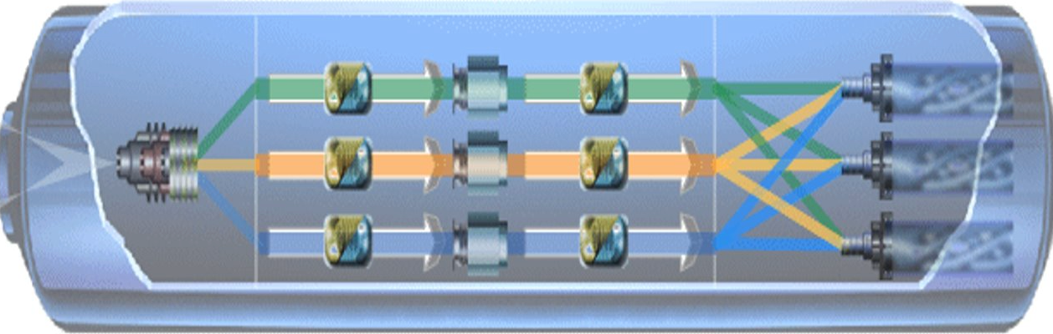















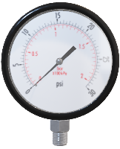


Anatomy of a Message Flow
Observe-ability / Monitor-ability
Ingest/Decrypt
Transform - Process - Transform
Encrypt/Emit
7
methods
Notes:
Talk about the Methodologies / Frameworks / Toolsets that you feel work best to solve the problem.

Slide 9


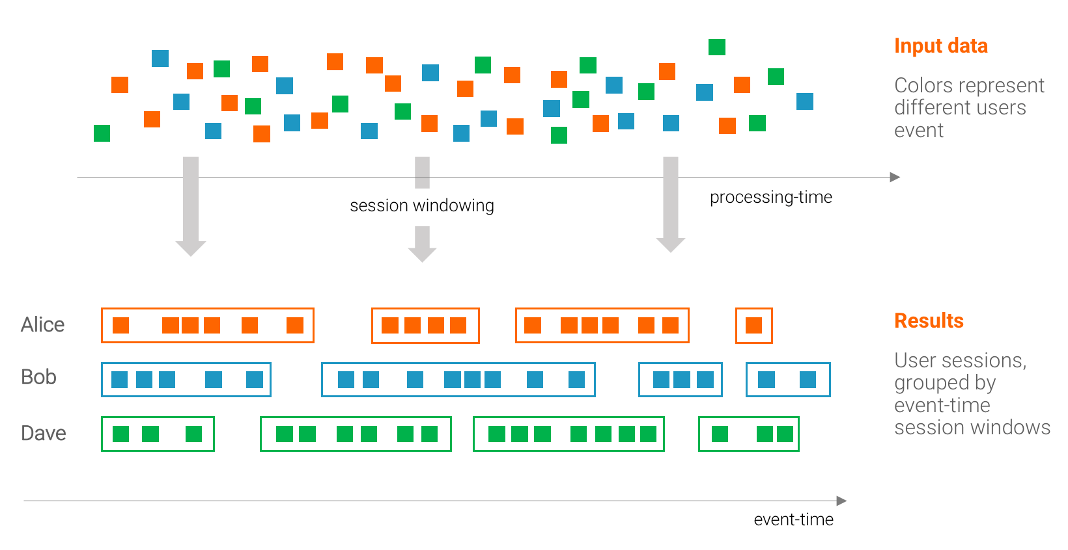
Enter Kafka
A single scalable platform to connect everyone to every event
Real-time stream of instantly (read / action) –able events
events are logged indefinitely
8
technology
Notes:
Talk about the Methodologies / Frameworks / Toolsets that you feel work best to solve the problem.

Slide 10
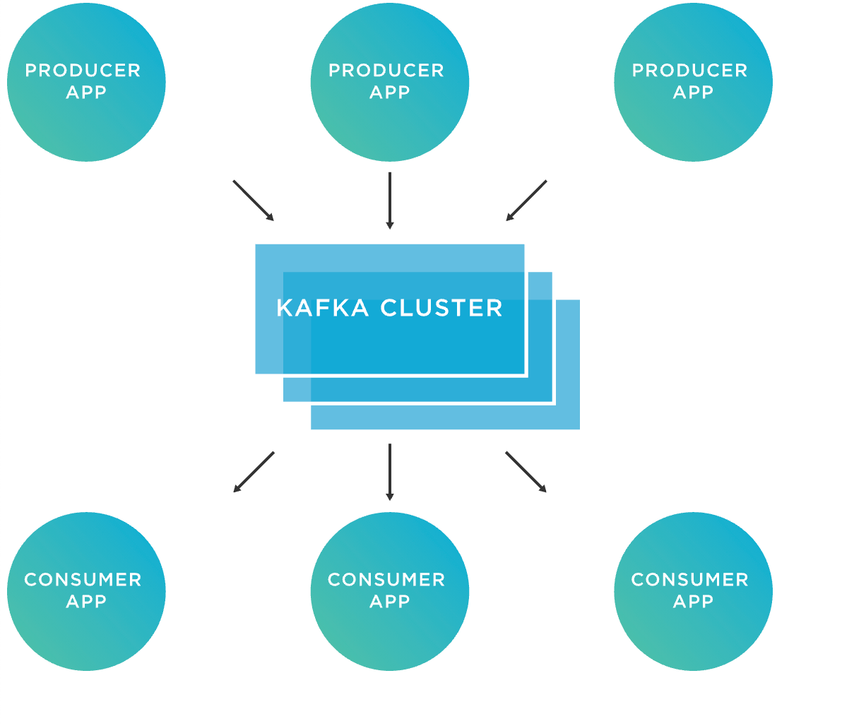
Kafka is
events streaming platform
open-source distributed
publish-subscribe
events stored in a log (topics)
geographically distributed
key/value pairs partitioned
persistent record of events
durable (written/replicated)
Notification
+
State
9
technology
Notes:
Talk about the Methodologies / Frameworks / Toolsets that you feel work best to solve the problem.

Slide 11









EDA
Rancher Kubernetes Engine (RKE) is a CNCF-certified Kubernetes distribution that runs entirely within Docker containers.
RKE – HA CLUSTER
Java Based Cloud Drive to Kafka
Java Based Cloud Drive to Kafka
Log Aggregation Collection
Java Based Cloud Drive to Kafka
Kafka Broker
Kafka Broker
Kafka Broker
PowerApps
RPA Email to Kafka
Notification Manager
Kafka Cluster
TOPIC
Partition 0
Node/Express
Webapp Upload to Kafka
0
1
2
3
4
5
6
7
8
9
10
1 1
12
Book Shelf Blob Store
Partition 1
0
1
2
3
4
5
6
7
8
9
Book Binder
Kafka Connect
Book Binder
Book Binder
Partition 2
Bookie
0
1
2
3
4
5
6
7
8
9
10
11
12
Producers
Consumers
Old
New
10
technology
Notes:
Talk about the Metshodologies / Frameworks / Toolsets that you feel work best to solve the problem.

Slide 12




Now Apps - Topics
Kafka Connect
Save to OneDrive
File saved
aggregate logs
Java Based Cloud Drive to Kafka
Log messages
New Relic
File uploaded
topic: log
upsert doc
Log messages
Dave
topic: thebook
topic: docin
Generate thebook
Save thebook
Bookie
new book notification
Email Notify
11
technology
Notes:
Talk about the Metshodologies / Frameworks / Toolsets that you feel work best to solve the problem.

Slide 13
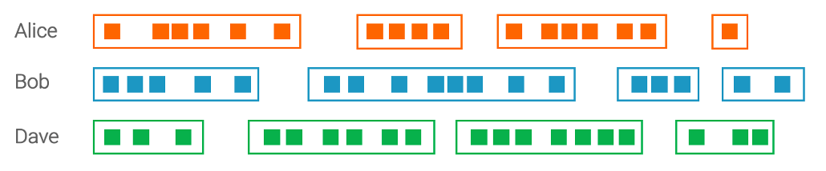

New Apps - Topics
thebook
ask onboard about the book
The book for this month was updated 54 times, The last updated today at 11:01 am, 1 images was added by Bob. Other recent changes include "the marketing pdf" was updated by Alice and the "sales xls" was updated by Dave.
Send me the latest copy
I am emailing you the latest version of "The Book"
12
technology
Notes:
Talk about the Metshodologies / Frameworks / Toolsets that you feel work best to solve the problem.

Slide 14
Confluent Platform A Complete Set of development, operations, and management capabilities to run Kafka at scale
13
technology
Notes:
Talk about the Metshodologies / Frameworks / Toolsets that you feel work best to solve the problem.

Slide 15
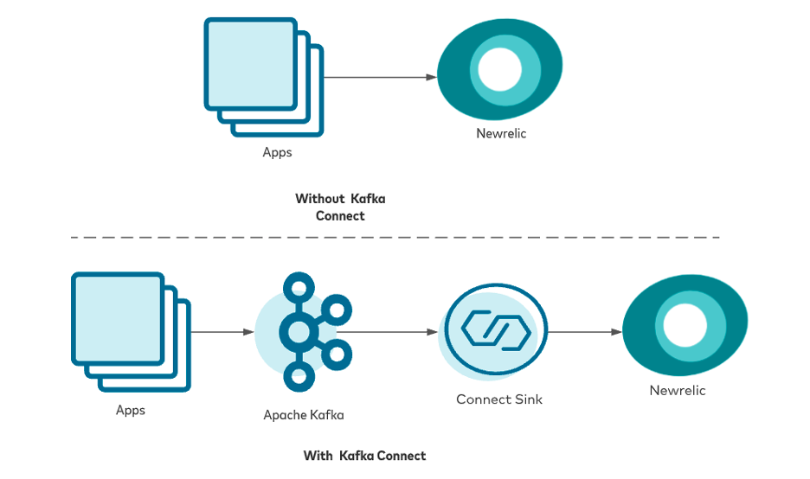
Distributed Log, Observable, Monitored
New Relic APM
SaaS focused on performance and availability monitoring
Connects app and infrastructure perf
Rich, detailed transaction data
Realtime error analysis
14
solution
Notes:
Present your solution!
Context is key
Assumptions are necessary
Avoid un-necessary implementation detail

Slide 16
References
What is Apache Kafka? Tim Berglund
Kafka 101 Events
Kafka 101 Topics
Kafka 101 Partitioning
Designing Event Driven Systems Ben Stopford
Enterprise Integration Patterns Hope and Bobby Woolf
Technology Strategy Patterns Eben Hewitt
PDFTRON samples
Links
infoslack/awesome-kafka
Apache Confluence
15
solution
Notes:
Present your solution!
Context is key
Assumptions are necessary
Avoid un-necessary implementation detail

